Slide 1
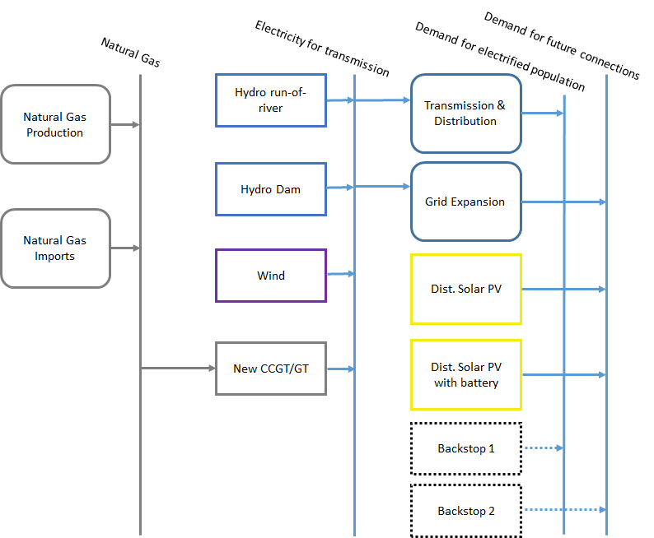
Thermal power plants in the RES
Resources
Primary
Secondary
Final

Slide 2
Thermal power plants in the RES
Resources
Primary
Secondary
Final

Slide 3
Examples
Coal
Coal-fired Power Plant
Electricity
Biomass/Waste
Biomass-fired Power Plant
Electricity
Natural gas
Natural gas-fired Power Plant
Electricity
Heavy fuel oil
Oil-fired Power Plant
Electricity
Diesel
Diesel-fired Power Plant / Engine
Electricity

Slide 4
Sample characteristics of thermal power plants
Coal
Coal-fired Power Plant
Electricity
Best Available Technology
Capital cost | 2200 $/kW
VOM and FOM cost | 88 $/kW/a
Capacity Factor | 75-80%
Efficiency | 46%
Integrated Gasification Combined Cycle
Capital cost | 3700 $/kW
VOM and FOM cost | 148 $/kW/a
Capacity Factor | 75-80%
Efficiency | 46%
Source: ETSAP.
Notes:
ETSAP = Energy Technology Systems Analysis Program

Slide 5
Sample characteristics of thermal power plants
Natural gas
Natural gas-fired Power Plant
Electricity
OCGTs
Capital cost | 900 $/kW
VOM and FOM cost | 36 $/kW/a
Lifetime | 30 years
Efficiency | 35-42%
CCGTs
Capital cost | 1100 $/kW
VOM and FOM cost | 44 $/kW/a
Lifetime | 30 years
Efficiency | 52-60%
Source: ETSAP.
Notes:
OCGT Open Cycle Gas Turbine
CCGT Combined Cycle Gas Turbine

Slide 6
Sample characteristics of thermal power plants
Heavy fuel oil
Oil-fired Power Plant
Electricity
Diesel
Diesel-fired Power Plant / Engine
Electricity
HFO Gas Turbines
Capital cost | 1490 $/kW
Efficiency | 35%
Diesel generators
Capital cost | 780 $/kW
FOM cost | 8 $/kW/a
Efficiency | 35%
Source: ETSAP.

Slide 7
Sample characteristics of thermal power plants
Biomass
Biomass-fired Power Plant
Electricity
Biomass CHP plant
Capital cost | 3000-6000 $/kW
FOM cost | 100 $/kW/a
Fuel cost | 30-50 $/MWh
Electric Efficiency | 16-36%
Totall Efficiency | 40-85%
Source: ETSAP.

